Slide 1

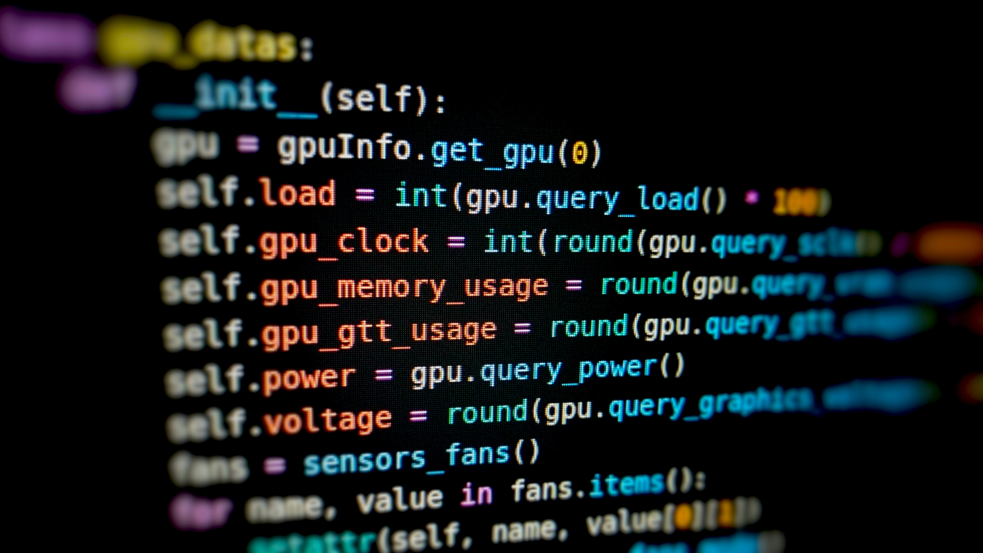
Deepraj Sarkar
CURRENCY ANALYSIS using Python
by Deepraj Sarkar

Slide 2


Agenda
Sl. no. | Contents | Page no.
1 | Table for technical indicators | 3
2 | Graphs for visually represent the data | 5
3 | Assumptions or approached taken | 9
Deepraj Sarkar

Slide 3
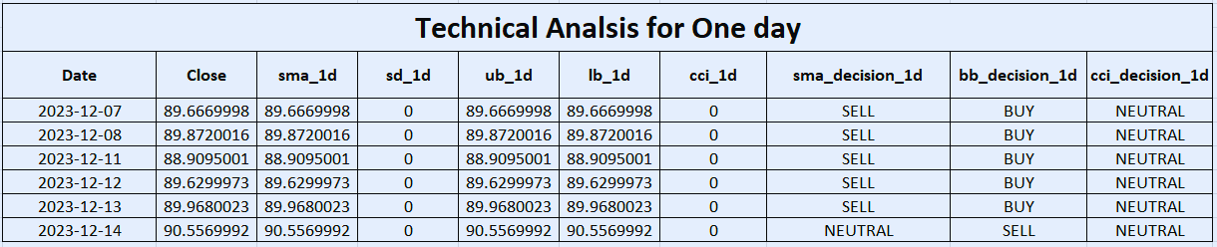
Table for trading decisions for One day
 | “sma_1d” = Simple Moving Average Calculation
 | “sd_1d” = Standard Deviation calculation for Bollinger Band
 | “ud_1d” = Upper Band calculation for Bollinger Band
 | “ld_1d” = Lower Band calculation for Bollinger Band
 | “cci_1d” = Commodity Channel Index calculation
In this table you can see all the analysis done for one day from 07-12-2023.
Deepraj Sarkar
Deepraj Sarkar

Slide 4
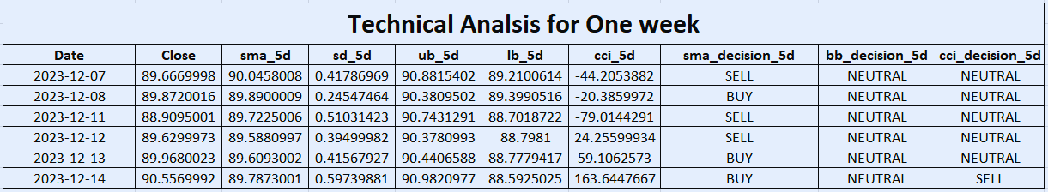
Table for trading decisions for One week
 | “sma_5d” = Simple Moving Average Calculation
 | “sd_5d” = Standard Deviation calculation for Bollinger Band
 | “ud_5d” = Upper Band calculation for Bollinger Band
 | “ld_5d” = Lower Band calculation for Bollinger Band
 | “cci_5d” = Commodity Channel Index calculation
The foreign exchange (forex) market operates 24 hours a day, five days a week.
For this reason we need to consider 5 as window size for a week.
In this table you can see all the analysis done for one week from 07-12-2023.
Deepraj Sarkar
Deepraj Sarkar

Slide 5
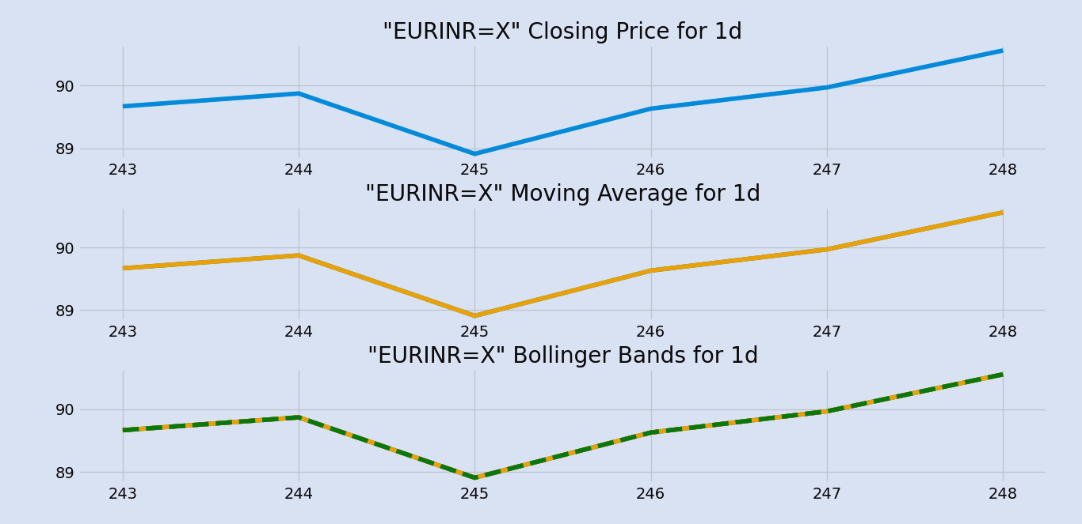
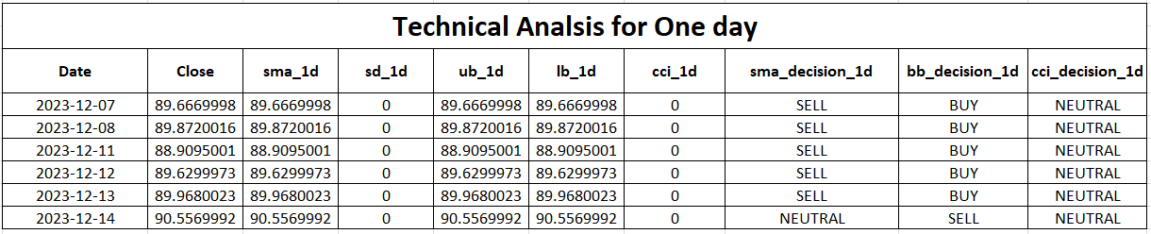
Graph representing Close price, SMA, Bollinger Bands & CCI for 1 day
When an asset's price crosses above its moving average, it may indicate a bullish trend and could be a good time to buy.
Conversely, when an asset's price falls below its 200-day moving average, it may indicate a bearish trend and could be time to sell.
Shorter SMA periods (e.g., 10, 20) are often used for short-term analysis providing a more responsive indicator to recent price movements
Longer SMA periods (e.g., 50, 100, 200) are often used for longer-term analysis, offering a smoother trend indication.
Deepraj Sarkar
Deepraj Sarkar

Slide 6
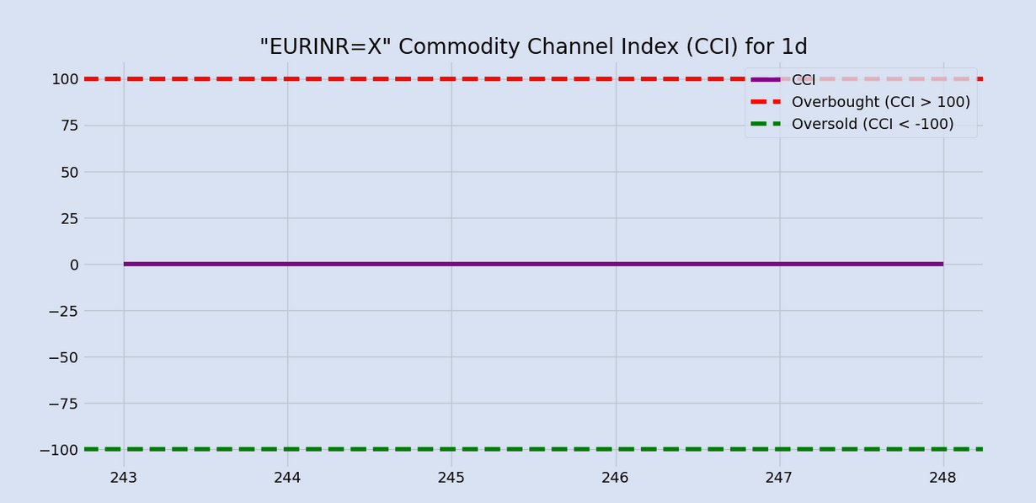
Graph representing Close price, SMA, Bollinger Bands & CCI for 1 day
Bollinger Bands answer one very basic question: Are prices high or low on a relative basis or has the price deviated too much from the mean price? It works around the law of mean reversal.
Overbought – the closer the prices move along the upper band, the more overbought the market
Oversold – the closer the prices move to the lower band, the more oversold the market.
The CCI typically oscillates between +100 and -100. Values above +100 indicate an overbought condition,
+100 Threshold: When the CCI moves above the +100, it is generally considered that the asset is overbought. This suggests that the price may be too high relative to its average and could be due for a pullback or reversal.
-100 Threshold: When the CCI moves below -100, it is generally considered that the asset is oversold. This suggests that the price may be too low relative to its average and could be due for a bounce or reversal.
Deepraj Sarkar
Deepraj Sarkar

Slide 7
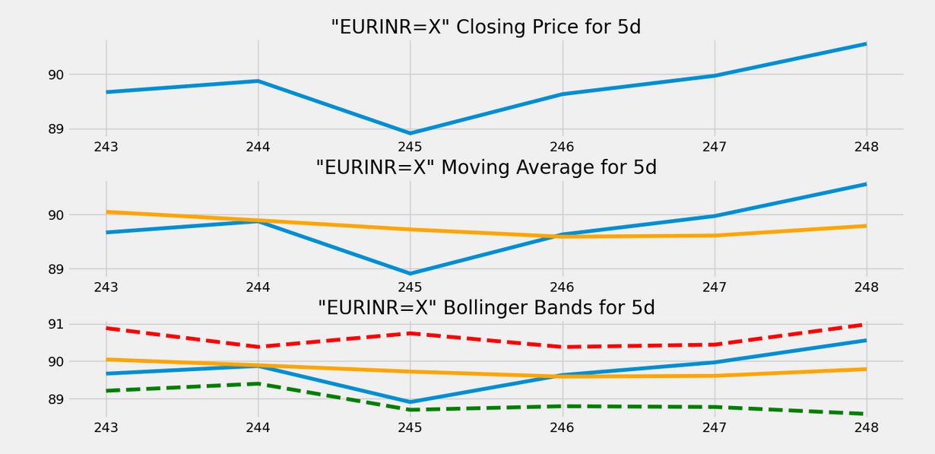
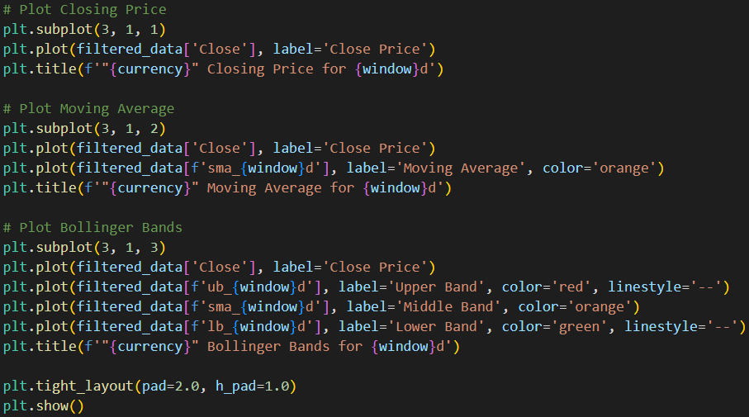
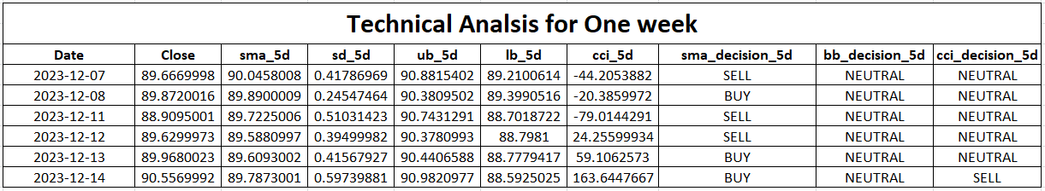
Graph representing Close price, SMA, Bollinger Bands & CCI for 1 week
Deepraj Sarkar
Deepraj Sarkar

Slide 8
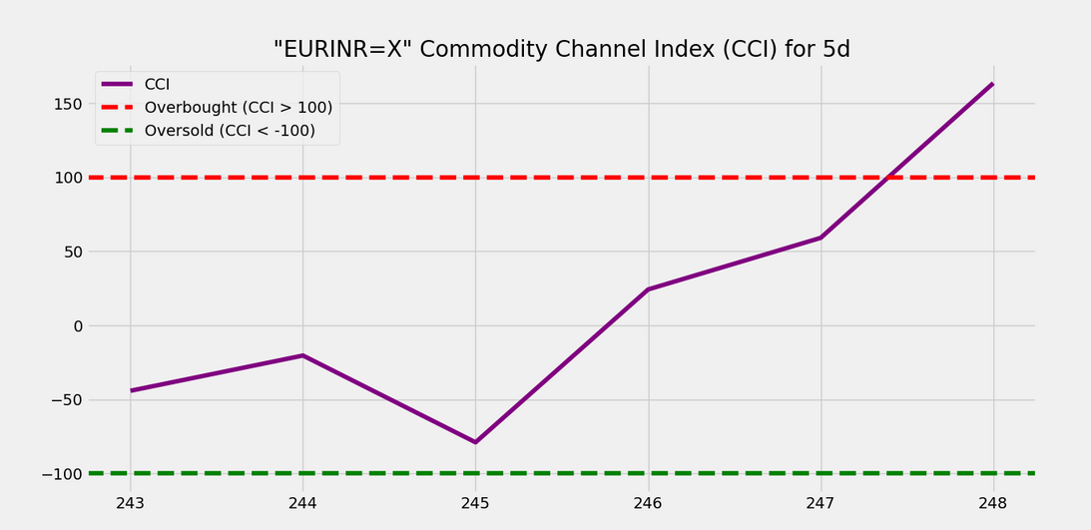
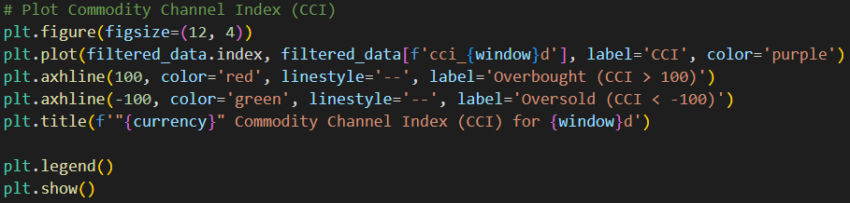
Graph representing Close price, SMA, Bollinger Bands & CCI for 1 week
The CCI is calculated using the following formula: CCI=(TP−SMA(TP,N)/(0.015∗D)
TP = Typical Price, calculated as the average of the high price, low price and close price.
SMA(TP,N) = Simple Moving Average of the Typical Price over N periods.
D = Mean Deviation, calculated as the average of the absolute differences between each Typical Price and the SMA(TP,N) over N periods.
Deepraj Sarkar
Deepraj Sarkar

Slide 9
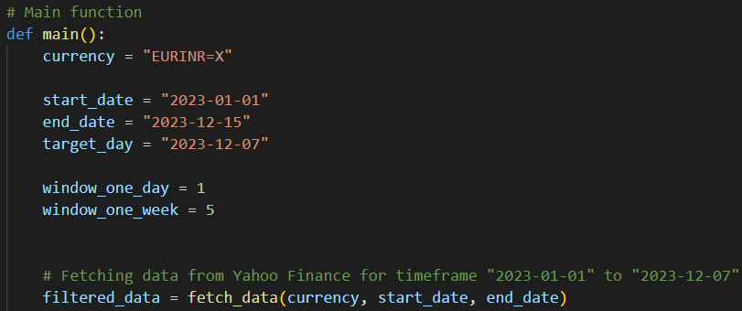
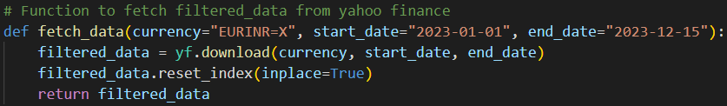
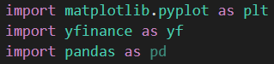
Assumptions or Approaches taken
This is the main function.
Here we have currency variable with the currency name, start date & the end date is set 1 day more as mentioned in the assignment as it exclude the day.
Target day is for filtering the one week data from target day.
There is two window variable for two different window.
fetch_data function fetch the data and store it to filtered_data variable.
This is the fetch_data function here in the function parameter we can set default values using ‘=’ operator.
It uses yfinance library that allows us to easily download financial data from Yahoo Finance.
reset_index reset the index column as for yfinance dataset the default behavior is to set the index column to be of the datetime type.
Here matplotlib & yfinance library are used for analysis.
pandas library is used here only to save the dataset in the excel file.
Deepraj Sarkar
Deepraj Sarkar

Slide 10
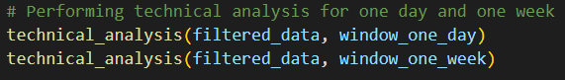
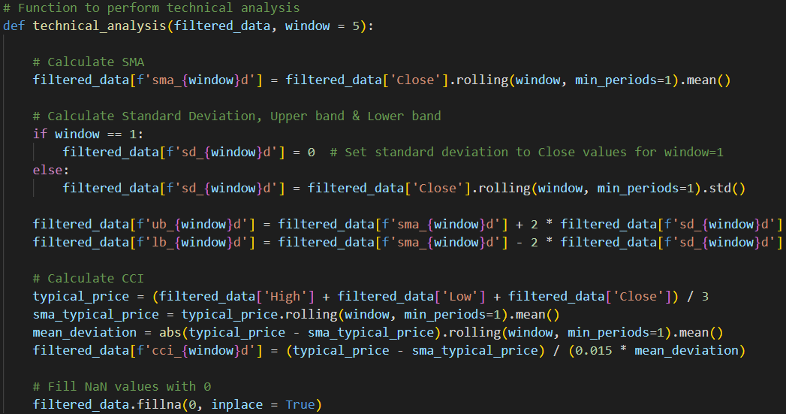
Assumptions or Approaches taken
This is the technical_analysis function where we mainly calculating the indicators.
Two times this function is called with the dataset & window size.
Then we are calculating Simple Moving Average respect to the ‘Close’ values & storing the data in the same dataset with different column name using the f-string formatting method.
Now if the window value is 1, the standard deviation values are 0, as the window is too small.
Now we are calculating upper bound & lower bound values.
Then the CCI is calculated.
At the last we are filling any NaN values with 0 with ‘fillna’ method.
We can’t use ‘dropna’ method as it will remove the entire row.
Deepraj Sarkar
Deepraj Sarkar

Slide 11
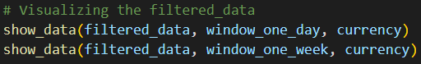
Assumptions or Approaches taken
Here we are extracting the mentioned one week data and storing it in the same dataset as we have already calculated the technical indicators.
Then we are sending the extracted data in show_data function to build the graphs.
We used matplotlib library to visualize data. We have used subplot method to plot Close price, Simple Moving Average & Bollinger Bands in a same figure.
A new figure is used for CCI data visualization.
Deepraj Sarkar
Deepraj Sarkar

Slide 12
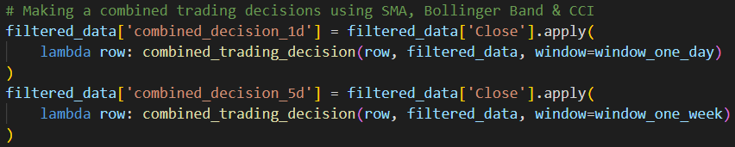
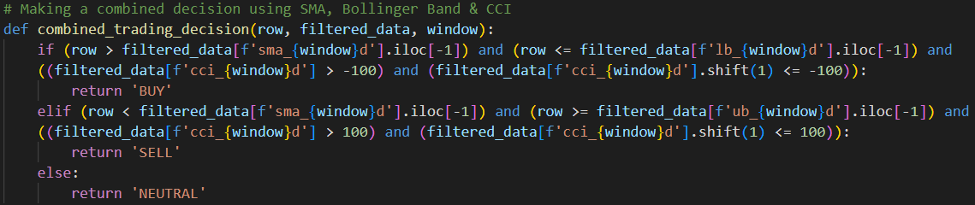
Assumptions or Approaches taken
Here we are making a new row in the dataset for combined decision.
We need to make decision for every row and for that we have used apply method.
We also need to combine the lambda method with the apply method to execute the plan correctly.
apply method will take each value from ‘Close’ column and using lambda function combined with combined_trading_decision function it’ll make the decision & save the value in the mentioned dataset column.
This function can predict three value ‘BUY’, ‘SELL’ or ‘NEUTRAL’.
Deepraj Sarkar
Deepraj Sarkar

Slide 13
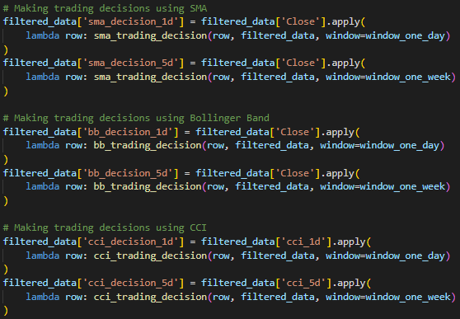
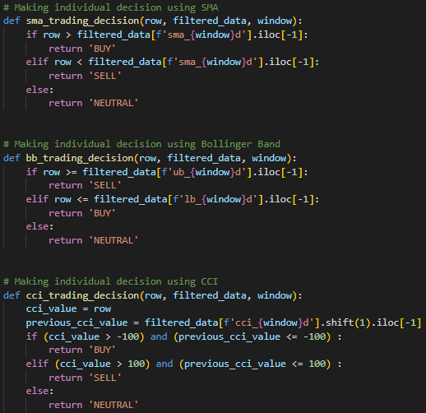
Assumptions or Approaches taken
Here we are calling three different functions, each twice, for calculating individual decision for trading.
One time with window 1 and again with window 5.
Functions are - ‘sma_trading_decision’, ‘bb_trading_decision’, ‘cci_trading_decision’.
Deepraj Sarkar
Deepraj Sarkar

Slide 14
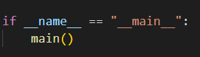
Assumptions or Approaches taken
Here we are storing the final dataset to the excel file.
The if __name__ == "__main__": construct in Python is a common idiom used to check whether a Python script is being run as the main program or if it is being imported as a module into another script.
This allows us to write code that can be both used as a standalone program and imported as a module without executing the code within the if __name__ == "__main__": block when imported.
Deepraj Sarkar
Deepraj Sarkar

Slide 15
Important Considerations
 | While SMAs are widely used, they are just one tool among many in technical analysis. It's essential to consider other indicators, risk management strategies, and fundamental analysis when making trading decisions.
 | It's crucial to use Bollinger Bands in conjunction with other indicators and tools for a comprehensive analysis. Avoid relying solely on Bollinger Bands. consider them as part of a broader trading strategy.
 | It's often recommended to use CCI in conjunction with other technical indicators or analysis methods for confirmation. Remember that while CCI can provide valuable insights, no single indicator is foolproof, and risk management is crucial. Traders often combine CCI with other indicators or use it as part of a comprehensive trading strategy.
 | Additionally, past performance is not indicative of future results, so use technical analysis cautiously and consider the limitations of such approaches. Additionally, practice in a simulated environment before applying these strategies in real trading. Additionally, it's important to backtest any strategy before applying it to real trading and to consider market conditions and other relevant factors.

Slide 16


